Slide 1
Today:
PDF and Kernel Density Estimation (chapter 6, workbook 10) :
Smooth histograms!
Some calculus (no calculations) background theory.
Lots of rambing – the key bits are relationships between charts, distributions, and usages.
Manipulating and analyzing one value at a time should be OK after this.
Load data, subset, compare, calculate stats, match dist., use analytical dist, graph.
Future:
Next we’ll start on looking at multiple variables – correlation.

Slide 2
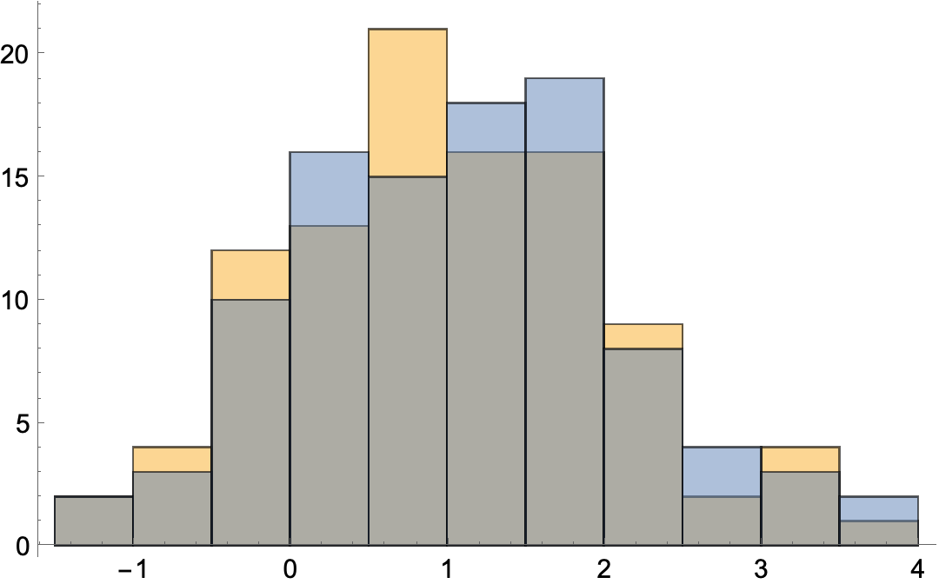
But First - Apples
Suppose I have two trees in my yard right beside each other:
One is a magic tree that has apple sizes that are normally distributed.
The other is a new tree that we hope is magic, but we don’t know.
I collect two samples of apples and create a histogram of both size distributions.
The values in the distributions will vary somewhat no matter what.
Apples are different sizes, no two apple buckets are exactly the same.
Even the ‘perfectly normal’ sample will vary from perfect somewhat – maybe we get extra big apples.
I hand you the apples distribution data and ask you – Did these two sets of apples come from the same tree or did the come from different trees?
You only know sizes, you didn’t see the apples or the picking.

Slide 3
What’s the Normal Test Asking?
These two distributions are very similar, how likely is it that they came from the same tree?
The two distributions are very different, how likely is it they came from the same tree?
Given the size of the difference, what is the probability that difference came from random variation in apple sizes vs being from a totally different distribution.
I.e. the apples have the same source, it was just random chance that one bucket is bigger.
This probability is the p value – likelihood the difference is just randomness.
In the normality test, one bucket is normal, we verify if the other matches that.
Did the thing we are checking come from the same source as the known normal bucket?

Slide 4
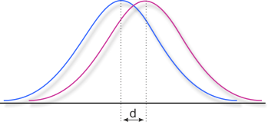
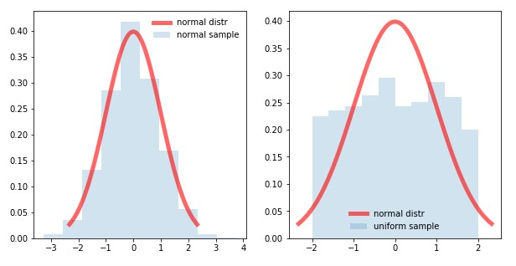
Are the Samples from
Different Distributions?
Difference seen between normal and data.
Is that difference random variation?
In the left, probably yes.
In the right, no.
The normal ‘sample’ and the left data could both be samples from the same source.
I.e. if we took a sample, its shape being either would be fine.
The normal ‘sample’ and the right data came from different sources.

Slide 5
PDFs and KDE

Slide 6
Analytical CDF
Previously, we went from a distribution to an analytical Hist/PMF/CDF by:
Adding up the cumulative totals of the empirical values to make an empirical cdf.
Looking to ‘match’ that empirical distribution to an analytical one, defined by a formula.
The CDF has a direct relationship to the PMF and Histogram;
PMF/Hist show the count/probability of values at a point (or in a range).
CDF shows the running total.
The analytical CDF has an analog – a Probability Density Function (PDF)
CDF shows the running total.
PDF shows the probability at a point ← More on the ‘point’ in a moment.

Slide 7
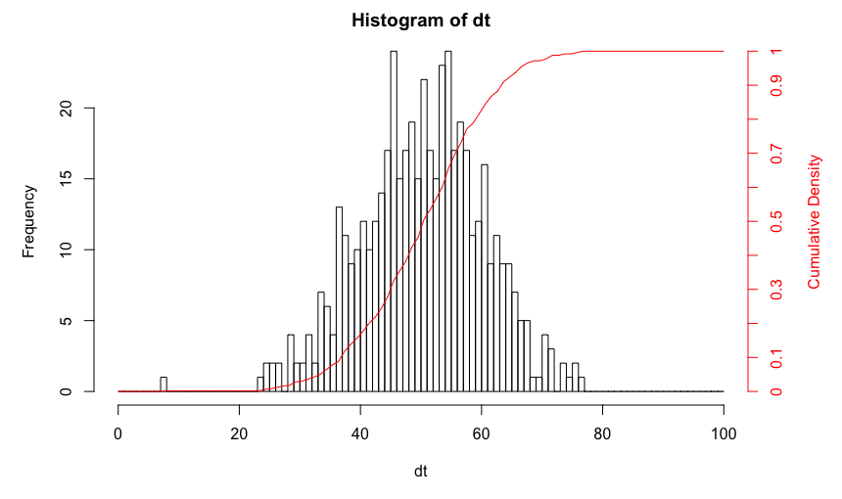
From a Histogram to a CDF

Slide 8
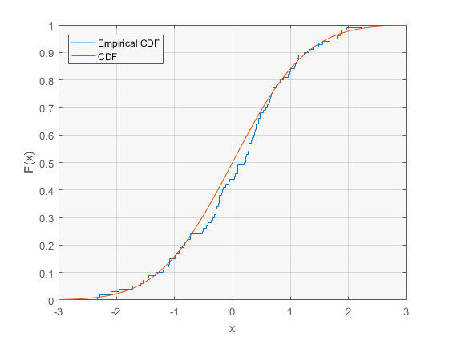
Empirical CDF to Analytical

Slide 9
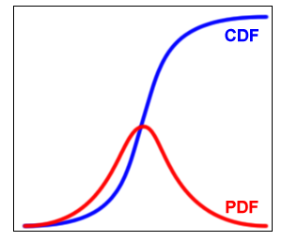
CDF to PDF

Slide 10
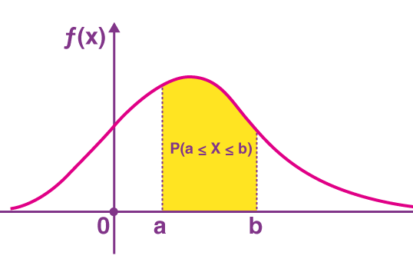
PDF Sans Adobe
The PDF is the ‘smooth’ visualization of the distribution.
Analytical not empirical.
Defined by a formula.
Even if we don’t have it handy.

Slide 11
Math!
If you know some calculus, we can explain the relationship in more depth.
If you don’t know any calculus, this isn’t something you need to do, it helps understanding.
Derivative – the slope (rate of change) at a specific point on a curve.
Integral – the area (accumulated total) under a curve.
Looking at a point on a cumulative graph tells us what has accumulated up to that point on a distribution graph.
Looking at the slope on a cumulative graph tells us the value at that point on a dist. Graph.
Looking at a point on a distribution graph tells us the slope on a cumulative graph.
Looking at the area under a distribution graph tells us the point on a cumulative graph.

Slide 12
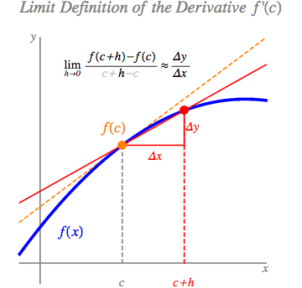
Derivative
The derivative of a function is its slope – or how much it changes over that time period.
E.g. the “slope” of an emperical cdf is the distance in height from one bin to the next.
How quickly the cdf is “going up”, the higher the value at the histogram is at that point.

Slide 13
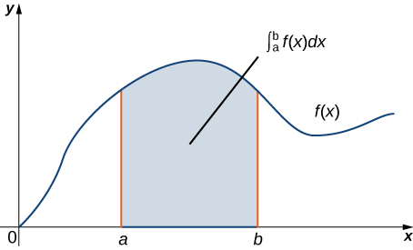
Integral
The integral is totaling up how much area is “under the curve” over a given interval.
E.g. The “total” area of a histogram bar is its height x size of the bin.
The total area under a PMF up to a point, is the value of the CDF at that point.

Slide 14
Relationships between Graphs
The empirical cdf ”goes up” by the count at that point in a histogram.
The histogram/pmf height at a point is defined by how much the cdf “jumps”.
The pdf height at a point is defined by the slope of the cdf (derivative)
The analytical cdf “goes up” by the amount at a point (integration).
Note: integration doesn’t work at a ‘point’, you need a range. This is why we get the density – probability per X.
E.g. With a PMF/Hist we are getting the same thing without thinking - the ”bins” are the translation from density to probability.

Slide 15
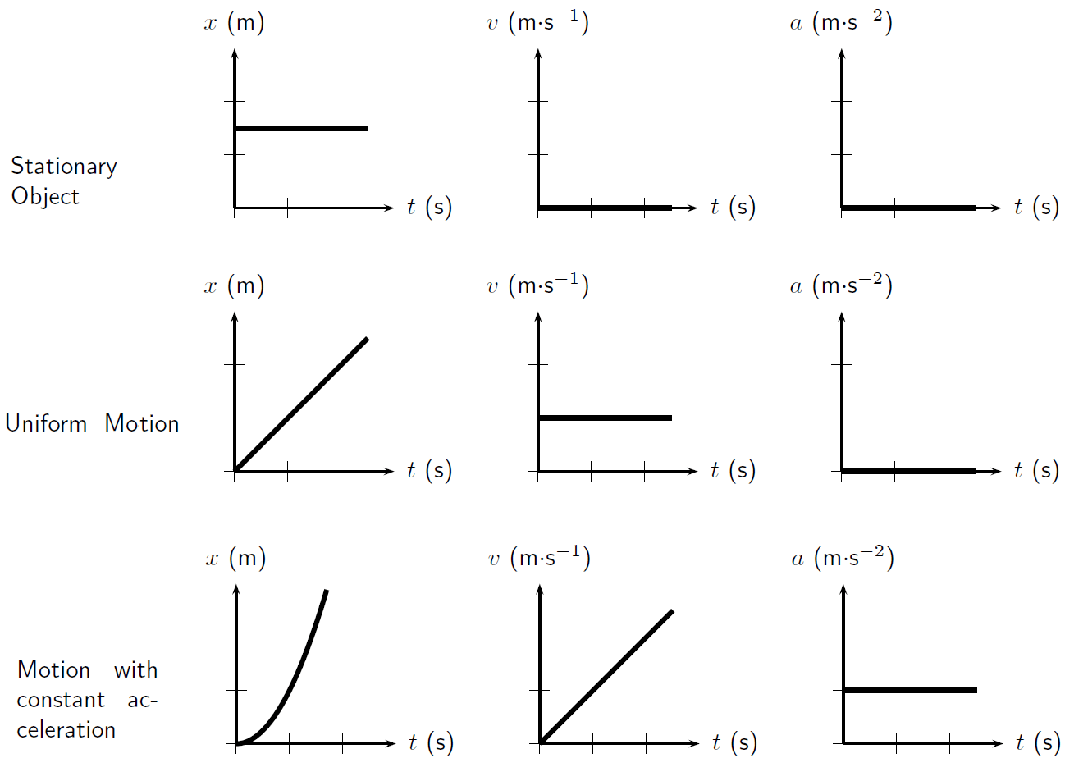

Slide 16
Derivative: CDF to PMF

Slide 17
Integral: PMF to CDF

Slide 18
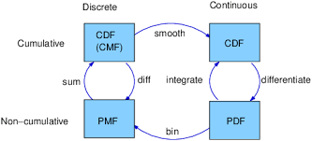
Relationships

Slide 19
What’s Going on here???

Slide 20
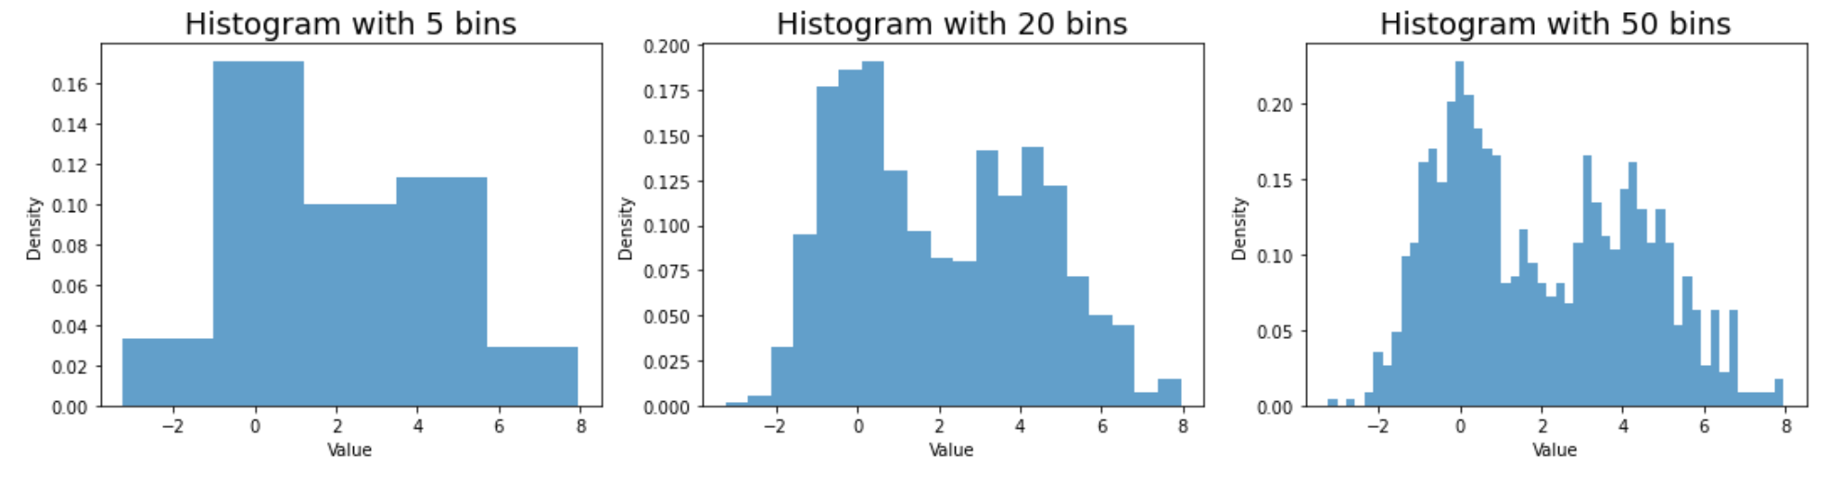
Density
A pmf/pdf gives us density – the likelihoods per X.
E.g. this one gives us probability per 2cm segment of height.
What if those bin sizes (segments) shrunk to virtually 0?
Recall – density is the percentage in that bin, or the probability of a random item from the sample being in that bin.

Slide 21
Kernel Density Estimation
Kernel Density Estimation is estimating the PDF. It is an approximation, like visually fitting an analytical CDF.
KDE can produce PDFs where there isn’t an apparent analytical match.
KDE can be done in an automated fashion.
Conceptually – what if a histogram’s bins got infinitely small.
KDE also has ‘smoothing’ – an attempt to generate a better approximation.
Correcting the histogram “gaps” that we saw with data that wasn’t binned.

Slide 22
KDE
We visually fit models to data previously.
KDE allows us to choose a ‘base model’ that is close, the system will ‘fine tune’.
Create a function from any data! Yay.

Slide 24
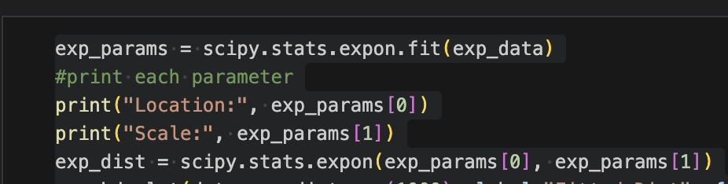
KDE Fitting
We can use the same concept as KDE to fit a model to data.
Each type of scipy model has a fit() function.
Takes in the dataset.
Returns the parameters.
This saves us a step of calculating the parameters separately.
Once fitted (no matter the method) scipy distributions can give us values:
PDF – what’s the pdf value at this point. I.e. how likely is it to have a record at this value.
CDF – what’s the csf value at this point. I.e. how many values are lower than this.

Slide 25

Let’s Take a moment

Slide 26
Moments
Moments can define the shape of a distribution.
We already use two:
Mean (1st moment)
Variance (2nd moment) – More frequently, the standard dev, which is the root.
There are two more:
Skew (3rd moment)
Kurtosis (4th moment)

Slide 27
Moments - Why
There are two types of moments – pg84.
Raw moments and central moments.
Raw – the values as they are.
Central – normalized*, centralized around origin.
Effectively the expected value of our data to k power:
K=1 – Mean. The expected value of our data.
K=2 – Variance. The expected value of distance from the mean.
K=3 – Skew. The expected value of distance from mean cubed – keeps the sign.
K=4 – Kurtosis. The expected value of distance from mean ^4.
Key for 3 and 4 – small values have little impact, large values have a huge one!
*Normalization is rescaling a value so the range is standardized. Will use lots in ML.

Slide 28
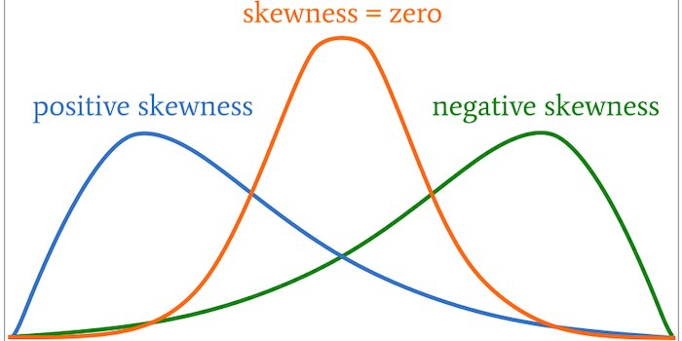
Skewness
Skewness is the 3rd moment; it is a measure of if a curve is shifted right or left.
The right or left is a measure of where the mean is vs the median.
The ^3 keeps +/-, and counts outliers a lot.
We have a couple of functions to calculate skew.

Slide 29
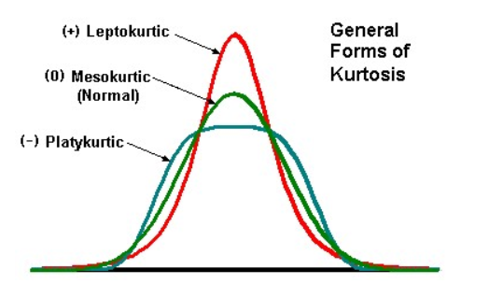
Kurtosis
Kurtosis is the 4th moment; it is a measure of how “peaky” the distribution is.
More accurately, it is a measure of ”how much tail” there is – big value, more of the distribution is in the tail.
Often expressed as excess kurtosis = kurt – 3. (Normal is 3, so this is how much “extra”).
The ^4 makes the calculation extreme – big impact on outliers.
The calculations are very sketch – this is normally used as a description. There are mult. calculations.

Slide 30
Moments in Practice
Mean and std are common – they provide info on our distribution.
Normal curve – provide mean and std to get the entire curve.
Skew and kurtosis are useful as concepts, less so as calculations.
Highly susceptible to outliers – distance from mean is raised to 3 or 4!
We don’t need to be moment experts past variance.

Slide 31
Conclusion
Increasingly, we want to think of things in terms of probability:
The distribution describes the probability of a record having each value.
The empirical counts are a record of what happened.
The better the sample represents the population, the better.
The analytical model is a definition of expectations.
We anticipate/expect future data to follow this distribution.
Quality of match is critical – model approximates reality.
Past performance is not a guarantee of future performance – but it can help!
Establish expectations based on data, use that to guide action.

